Slide 1
WEEK 5 BITE 2 LOGISTIC REGRESSION
7FNCE040W
Business Analytics

Slide 2
WEEK 5 BITE 2 LOGISTIC REGRESSION

Slide 3
Today’s Schedule We may need to continue next week
In-class Exercises
Logistic Regression
Individual CW

Slide 4
Dummy Variable DV – Examples?
Good customer – or not
Potential customer – or not
Brand loyal – or not
In target market – or not
Satisfied customer – or not
Notes:
Logistic regression is used when we have a dummy variable as the dependent variable
Dummy variable :
1 = in the category
0 = not in the category
Name some examples of marketing questions where the researcher wants to predict who is ‘in the category’, i.e. name some categories

Slide 5
Compared to OLS Regression
Characteristic | OLS Regression | Logistic Regression
DV | Metric: Interval or Ratio | Categorical: 0 or 1
Predictions | Predicted values are as close as possible to actual | Predicted value is a probability, p. Want ‘p’ to be close to 0 when Y = 0 and close to 1 when Y = 1
Estimation Objective | Minimise Sum of Squared Errors | Maximum Likelihood Estimation
Goodness of Fit | R² or Adj. R² | Cox & Snell R²; Nagelkerke R²; or % Correct
Distribution of Errors | Assumed to follow Normal Distribution | Assumed to follow Binomial Distribution
Parameter Significance Testing | t-stats | Wald Chi-Square Statistic
Notes:
Dependent variable: Present (1) versus absent (0)
The estimation procedure is called the maximum likelihood method
The aim of maximum likelihood estimation is to find the parameter value(s) that makes the observed data most likely
Fit: Two pseudo R2 calculations provided
Cox & Snell R Square and Nagelkerke R Square.
Both these measures are similar to R² in kinear regression.
The Cox & Snell R Square can not equal 1.0, even if the fit is perfect.
This limitation is overcome by the Nagelkerke R Square.
Compare predicted and actual values of Y to determine the percentage of correct predictions.

Slide 6
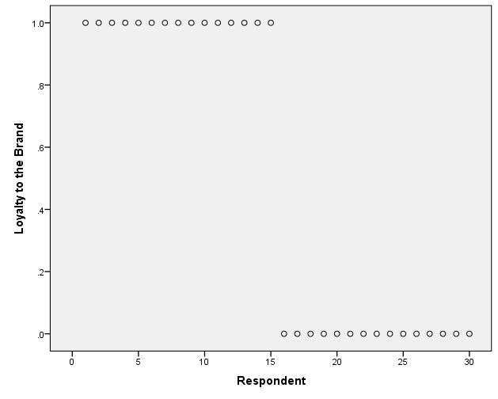
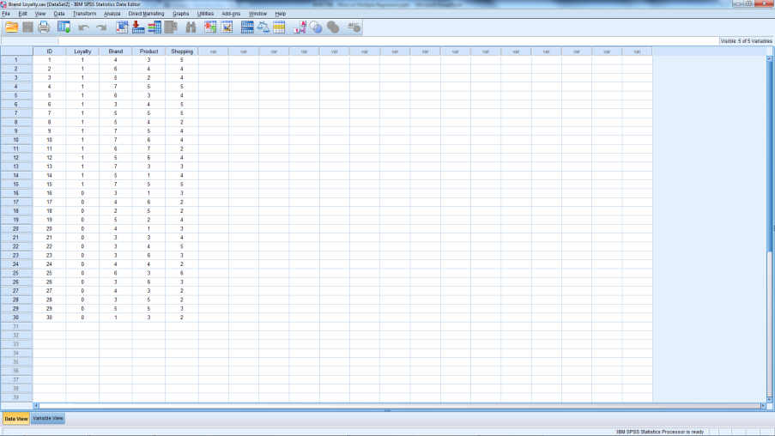
Brand Loyalty.sav
Notes:
The data file contains information from 30 respondents, 15 of whom are brand loyal (indicated by 1).
The other variables are measures of attitude toward the brand (Brand), attitude toward the product category (Product), and attitude towards shopping (Shopping), all on a 1 (unfavourable) to 7 (favourable) scale.
The objective is to estimate the probability of a consumer being brand loyal as a function of attitude toward the brand, the product category, and shopping.

Slide 7
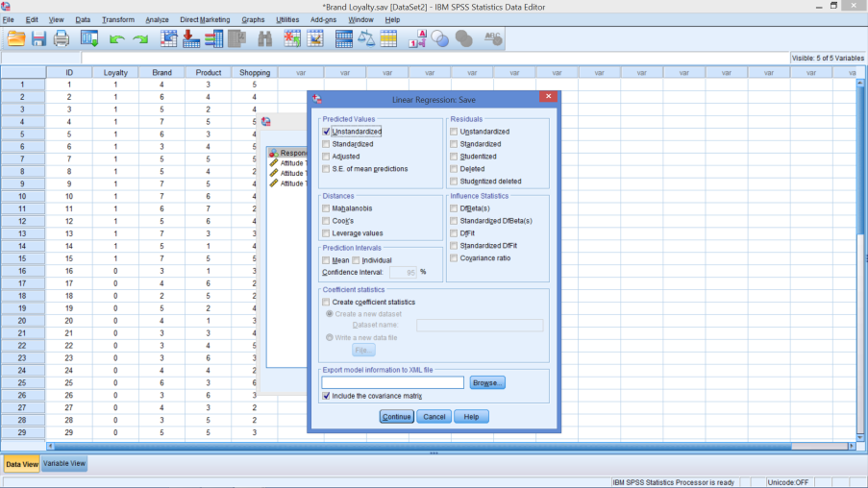
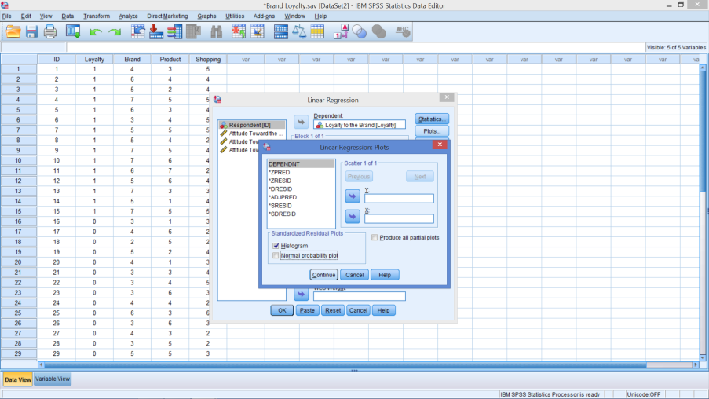
Run OLS Regression
Save Box
Plots Box
Notes:
Predict Loyalty from
Brand
Product
Shopping
Before hitting OK
Select Save
Under Predicted Values
Select Unstandardized
Select Plot
Select Histogram

Slide 8
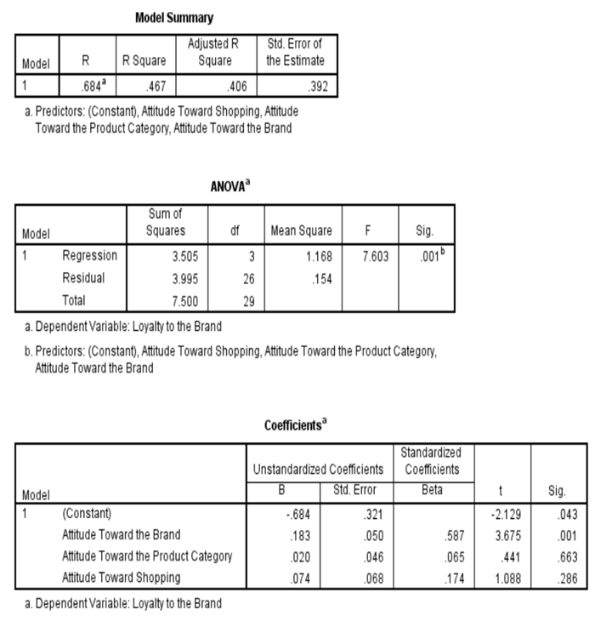
Output

Slide 9
OLS Regression Output
Is it a good model?
$$\hat{Y}=−.684+(.183 ∗Attitude towards Brand)$$
𝒀 ̂=−.𝟔𝟖𝟒+(.𝟏𝟖𝟑 ∗𝑨𝒕𝒕𝒊𝒕𝒖𝒅𝒆 𝒕𝒐𝒘𝒂𝒓𝒅𝒔 𝑩𝒓𝒂𝒏𝒅)
F
Are any parameters significant?
Which one(s)?
What is the regression model?
Adj. R²
Evidence?
Managerial implications?

Slide 10
OLS Regression Output
Is it a good model?
$\hat{Y}=−.684+\left(.183 ∗Attitude towards Brand\right)+…$nning
𝑌 ̂=−.684+(.183 ∗𝐴𝑡𝑡𝑖𝑡𝑢𝑑𝑒 𝑡𝑜𝑤𝑎𝑟𝑑𝑠 𝐵𝑟𝑎𝑛𝑑)+…nning
F
Are any parameters significant?
Which one(s)?
What is the regression model?
Adj. R²
Evidence?
Managerial implications?

Slide 11
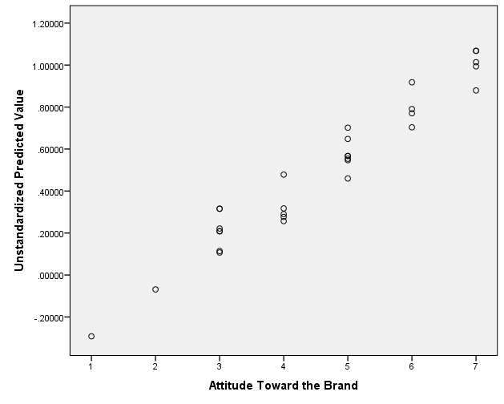
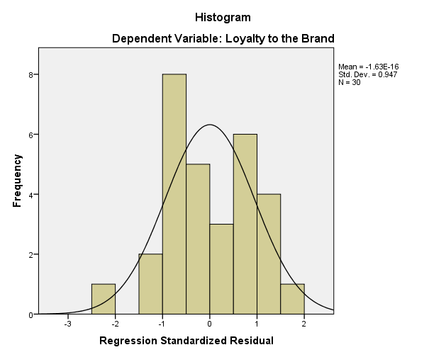
Any Problems?
Predictions
Distribution
Notes:
To create chart on left
Graphs
Legacy dialogs
Scatter/Dot
Simple Scatter → Define
X-axis = attitude towards the brand
Y-axis Unstandardized Predicted values
Predictions fall outside the range
Doesn’t look normal – which allows us to use the t statistics

Slide 12
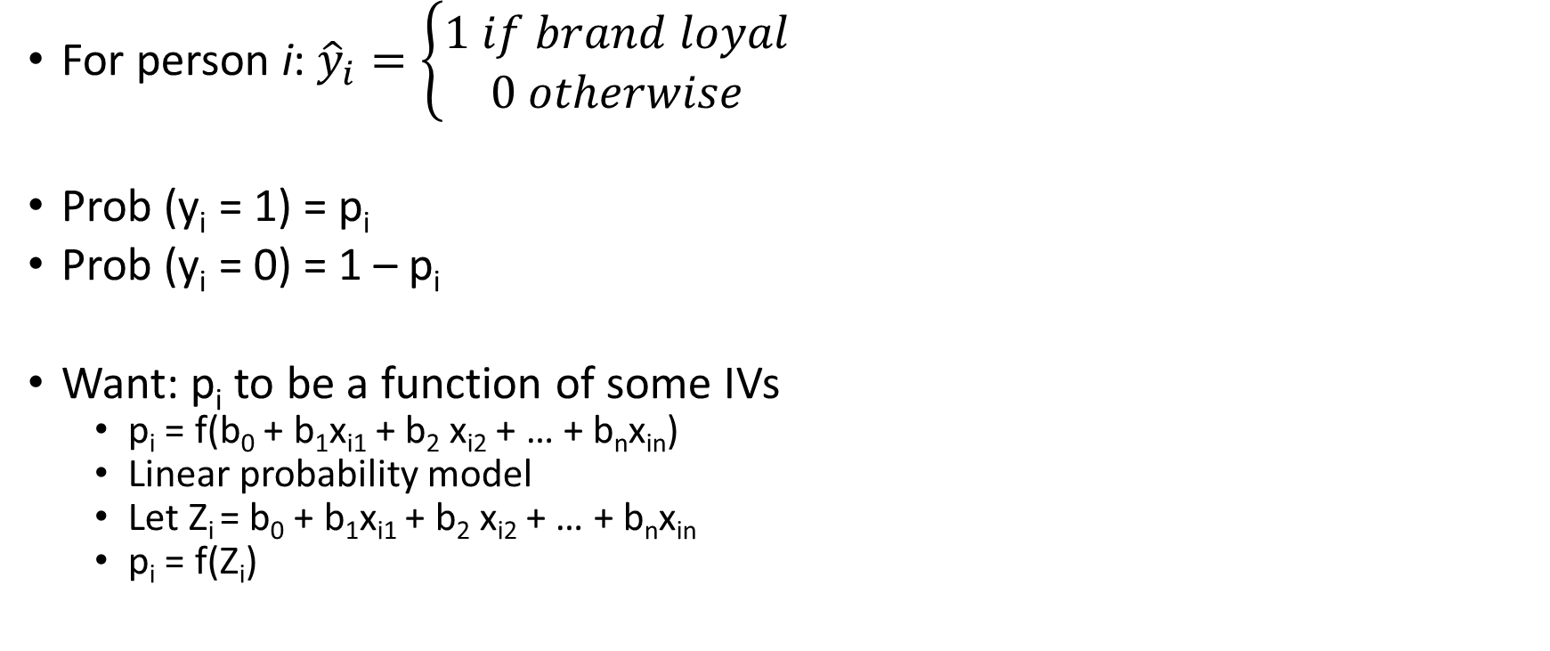
Intuition
For person i: ${\hat{y}}_{i}=\left\{\begin{aligned}1 if brand loyal \\ 0 otherwise\end{aligned}\right.$
Prob (y_{i} = 1) = p_{i}
Prob (y_{i} = 0) = 1 – p_{i}
Want: p_{i} to be a function of some IVs
p_{i} = f(b₀ + b₁x_{i1} + b₂ x_{i2} + … + b_{n}x_{in})
Linear probability model
Let Z_{i} = b₀ + b₁x_{i1} + b₂ x_{i2} + … + b_{n}x_{in}
p_{i} = f(Z_{i})
Notes:
Lots of formulas in the next few slides – don’t worry
Provided just to understand intuition, if inclined
Linear probability model looks good because we know how to estimated linear regression equations

Slide 13
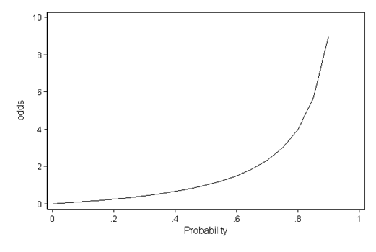
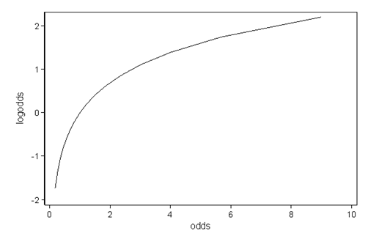
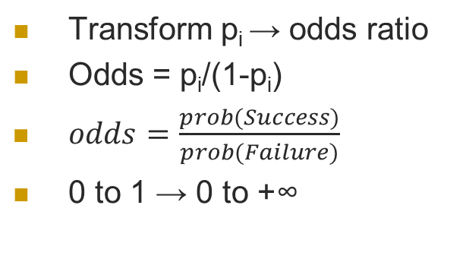
2-part Transformation
Transform p_{i} → odds ratio
Odds = p_{i}/(1-p_{i})
$odds=\frac{prob(Success)}{prob(Failure)}$
0 to 1 → 0 to +∞
odds → ln(odds)
Logit(p_{i}) = ln(p_{i}/(1- p_{i}))
0 to +∞ → -∞ to +∞
Easier to understand
Notes:
First, we move from the probability i to the odds
odds = pi / 1- pi
Which is defined as the ratio of the probability to its complement (probability of not happening)
The ratio of loyal to non-loyal cases.
Notes on interpretation of odds:
If the probability of an event is a half, the odds are one-to-one or even.
If the probability is 1/3, the odds are one-to-two. ((1/3) / (2/3)) = ½)
If the probability is very small, the odds are said to be long.
Odds can take any positive value and therefore have no ceiling restriction.
Second, we take logarithms, calculating the logit or log-odds
logit(pi) = ln(pi /1-pi)
which has the effect of removing the floor restriction.
Now, as the probability goes down to zero the odds approach zero and the logit approaches -∞.
At the other extreme, as the probability approaches one the odds approach +∞ and so does the logit.
Thus, logits map probabilities from the range (0 to 1) to the entire real line.

Slide 14
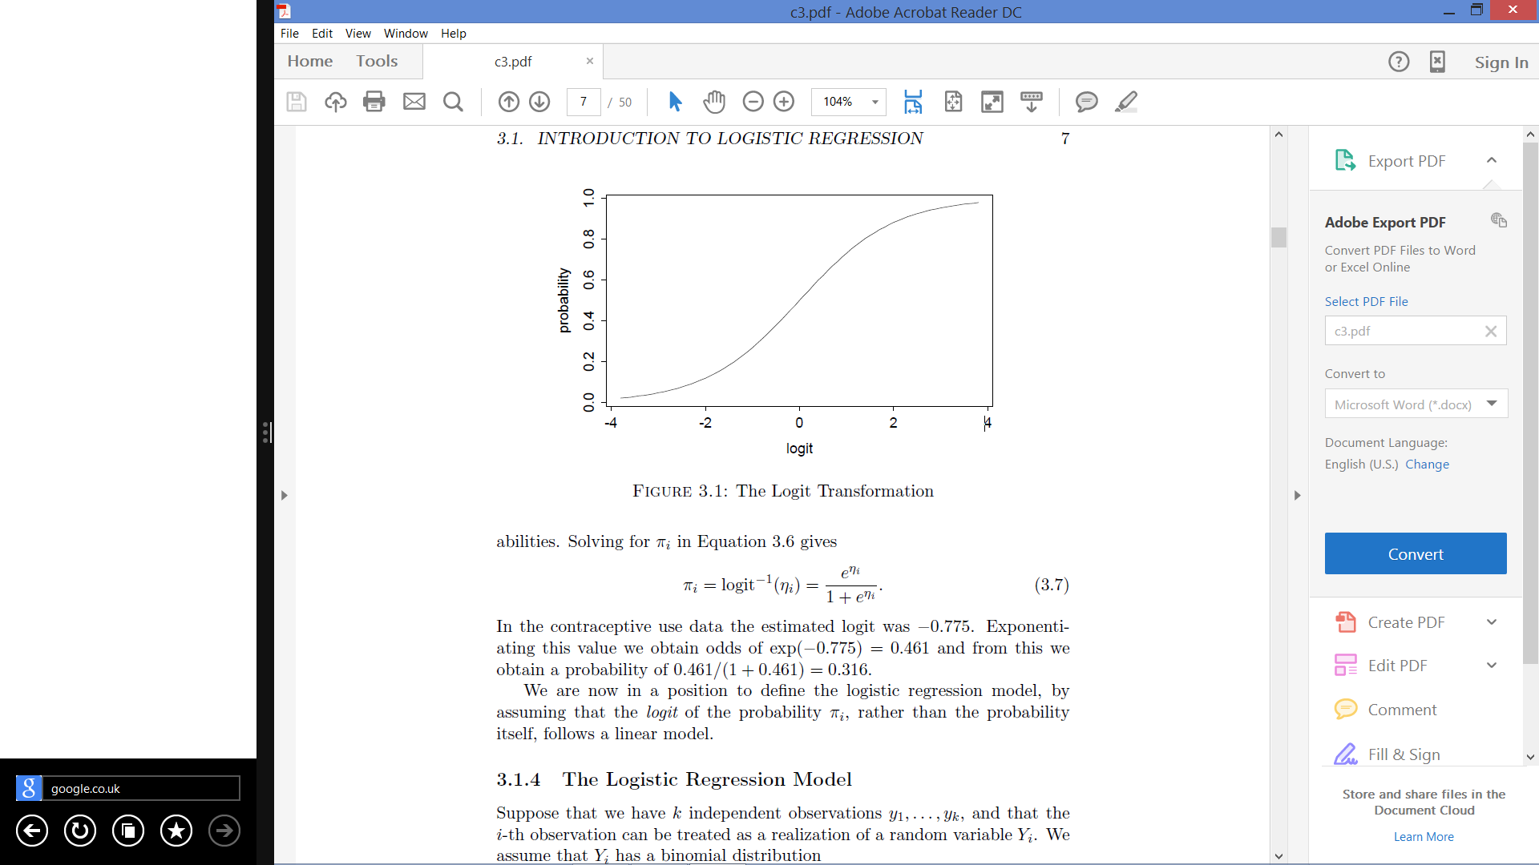
Transformed DV

Slide 15
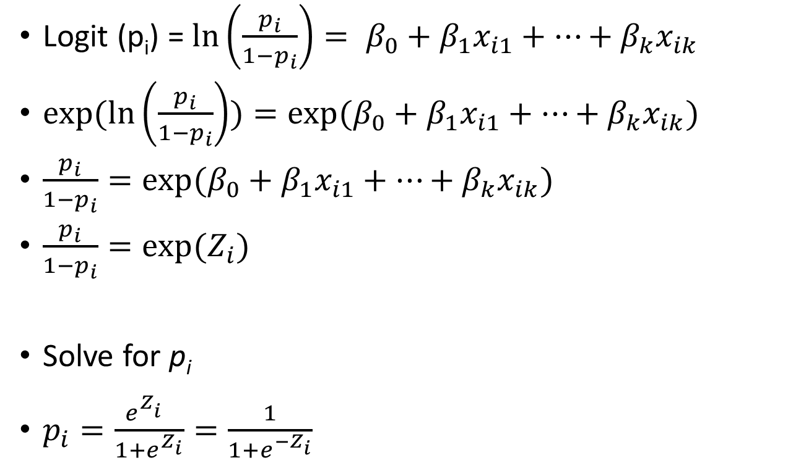
The Model
Logit (p_{i}) = $\ln\left(\frac{p_{i}}{1−p_{i}}\right)= β_{0}+β_{1}x_{i1}+…+β_{k}x_{ik}$
$exp(ln\left(\frac{p_{i}}{1−p_{i}}\right))=exp⁡(β_{0}+β_{1}x_{i1}+…+β_{k}x_{ik})$
$\frac{p_{i}}{1−p_{i}}=exp⁡(β_{0}+β_{1}x_{i1}+…+β_{k}x_{ik})$
$\frac{p_{i}}{1−p_{i}}=exp⁡(Z_{i})$
Solve for p_{i}
$p_{i}=\frac{e^{Z_{i}^{}}}{1+e^{Z_{i}}}=\frac{1}{1+e^{{−Z}_{i}}}$
Notes:
Start with the logit transformation
Now p_{i} is a function of our independent variables
Exponentiation of both sides
Solve for pi

Slide 16
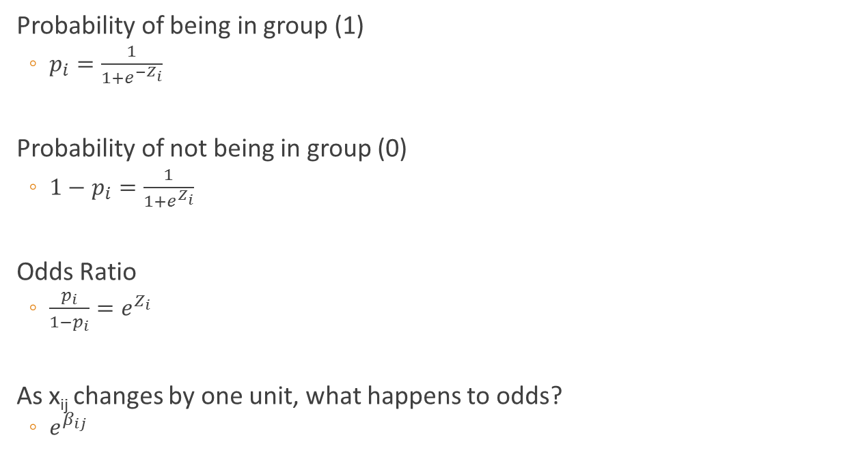
Algebra
Probability of being in group (1)
$p_{i}=\frac{1}{1+e^{−Z_{i}}}$
Probability of not being in group (0)
$1−p_{i}=\frac{1}{1+e^{Z_{i}}}$
Odds Ratio
${\frac{p_{i}}{1−p_{i}}=e}^{Z_{i}}$
As x_{ij} changes by one unit, what happens to odds?
$e^{β_{ij}}$
Notes:
i refers to person i
j refers to the jth variable

Slide 17
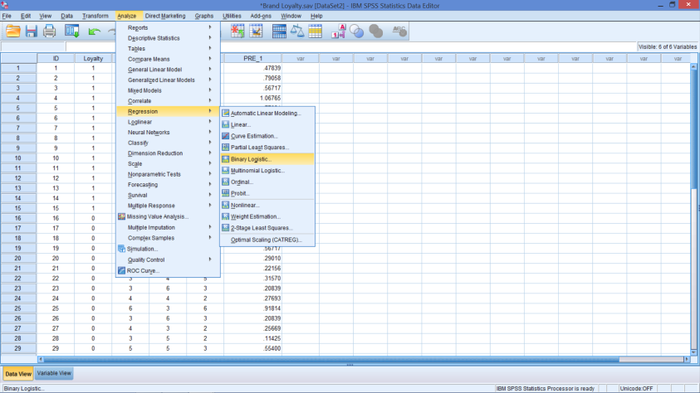
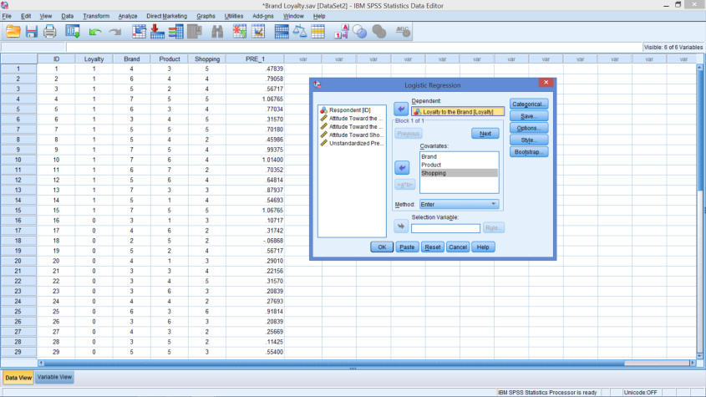
Binary Logistic Regression
To Begin
Specify the Model

Slide 18
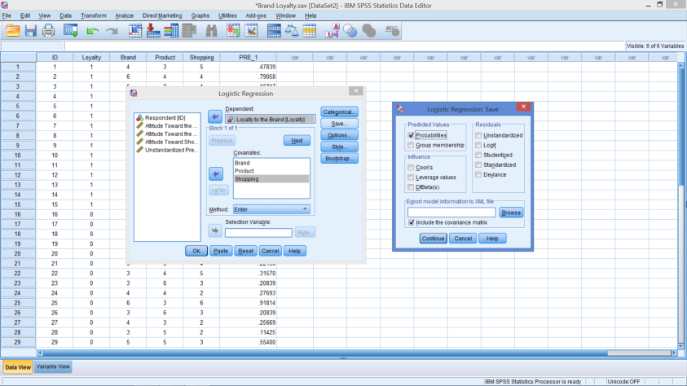
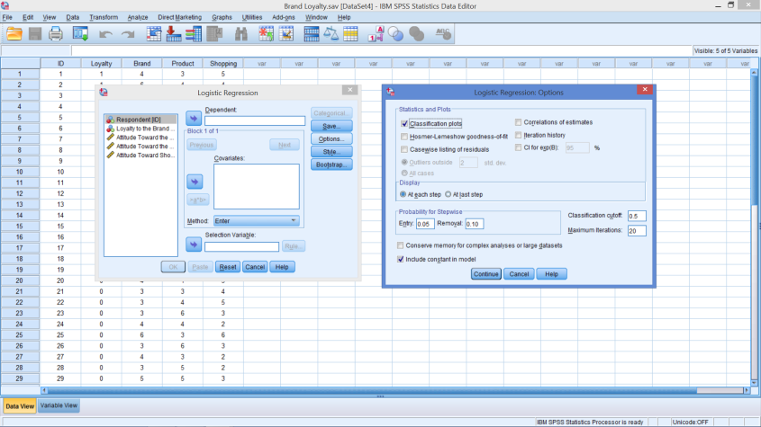
Binary Logistic Regression
In the Save Box
In Options
Notes:
Save Box – Select Probabilities (under Predicted Values)
Options Box – Select Classifications Plot (under Statistics and Plots)

Slide 19
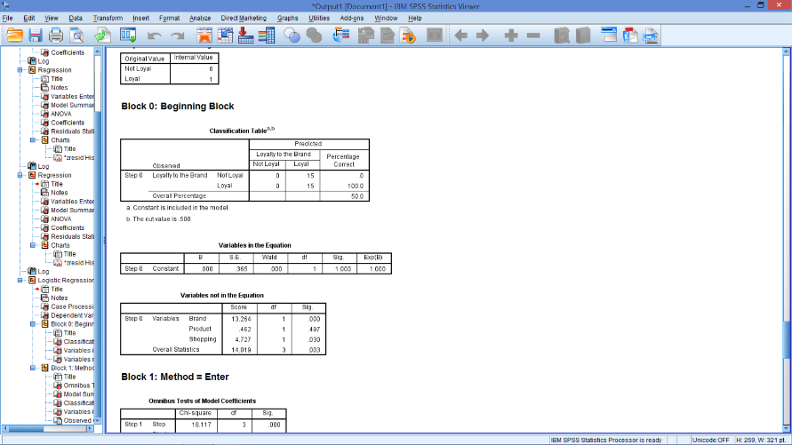
Block 0: Beginning Block
No predictors
Prob(loyal)
15/30 = .5
Notes:
In other words, the intercept from the model with no predictor variables is the estimated ln(odds) of being loyal.

Slide 20
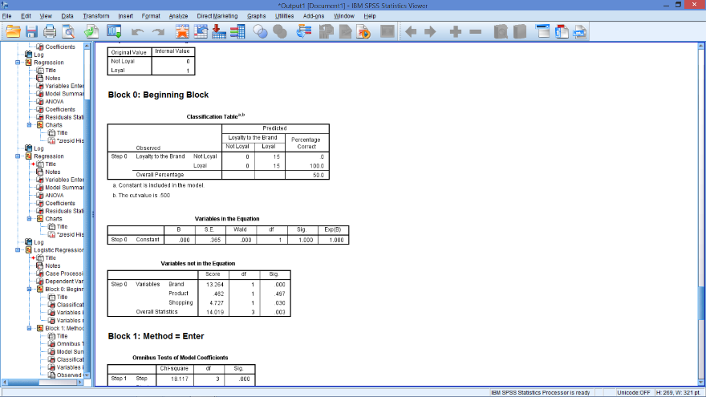
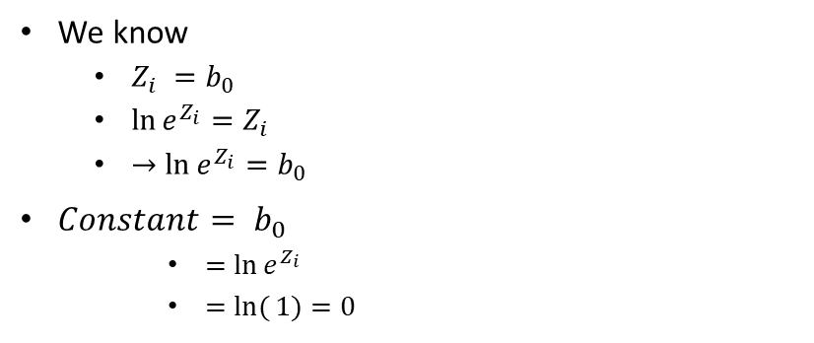
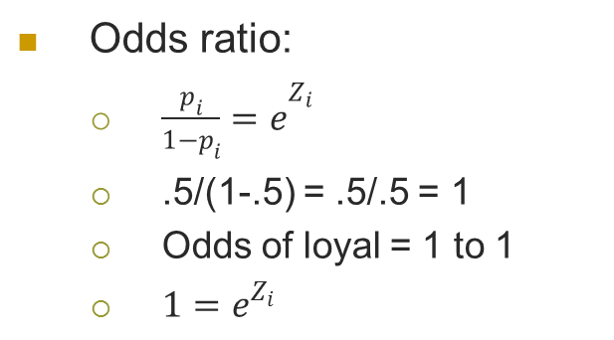
Block 0: Beginning Block
Odds ratio:
${\frac{p_{i}}{1−p_{i}}=e}^{Z_{i}}$
.5/(1-.5) = .5/.5 = 1
Odds of loyal = 1 to 1
${1=e}^{Z_{i}}$
We know
$Z_{i} =b_{0}$
$\ln{e^{Z_{i}}}=Z_{i}$
$→\ln{e^{Z_{i}}}=b_{0}$
$Constant= b_{0}$
$=\ln{e^{Z_{i}}}$
$=ln({1)=0}$
Notes:
In other words, the intercept from the model with no predictor variables is the estimated ln(odds) of being loyal.

Slide 21
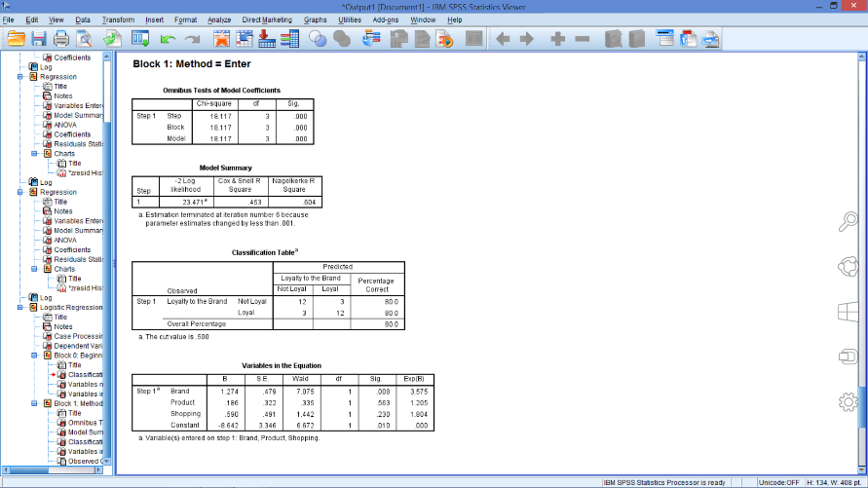
Block 1: Method = Enter
Omnibus Tests
Similar to F-stat
Something good in model
-2LL
Lower is better
Compare changes
Two R²
Cox & Snell = .453
Nagelkerke = .604
Notes:
Omnibus Tests of Model Coefficients
Step -- tests the contribution of the specific variable(s) entered on this step
Block -- tests the contribution of all the variables entered with this block
Model -- tests the fit of the whole model
These are all the same for a model with a single set of predictors that are entered simultaneously.
-2LL statistic measures how poorly the model predicts the decisions -- the smaller the statistic the better the model.
Although SPSS does not give us this statistic for the model that had only the intercept, we know it was 41.588 (=18.117 + 23.471)
Adding the three variables reduced the -2 Log Likelihood statistic by 18.117, the $x^{2}$ statistic, to 23.471.
R² measures
Cox & Snell R² cannot reach 1
Nagelkerke adjustments fixes this problem

Slide 22
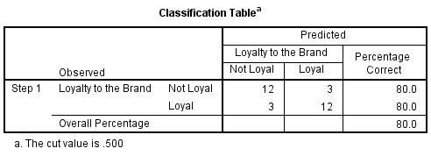
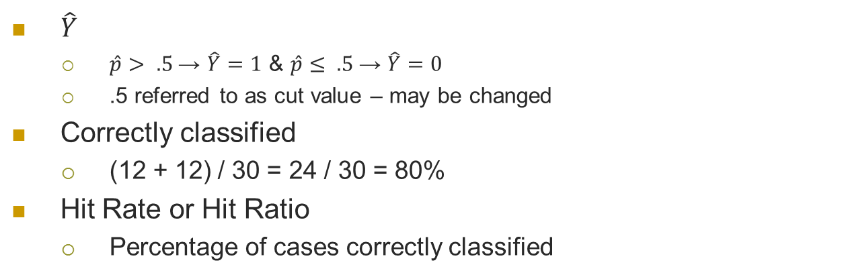
Classification Table
$\hat{Y}$
$\hat{p}> .5$→ $\hat{Y}=1$ & $\hat{p}≤ .5$→ $\hat{Y}=0$
.5 referred to as cut value – may be changed
Correctly classified
(12 + 12) / 30 = 24 / 30 = 80%
Hit Rate or Hit Ratio
Percentage of cases correctly classified

Slide 23
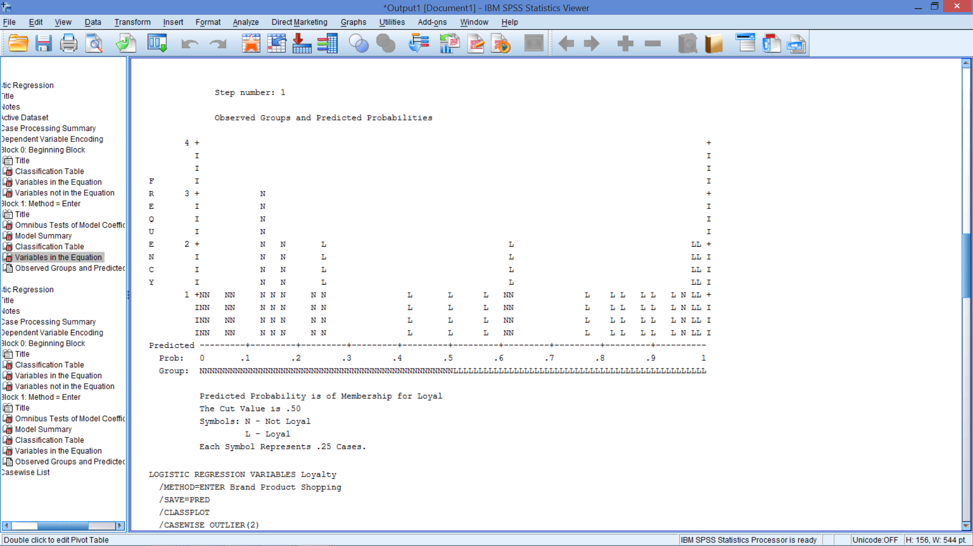
Classification Plot
Notes:
We have 6 observations that were incorrectly classified.
Therefore we should have 24 N’s and L’s on the ‘wrong’ side of .5. (Each symbol represents .25 cases)
This type of plot may give a sense for where the model is having trouble making predictions, depending on the location of the errors.

Slide 24
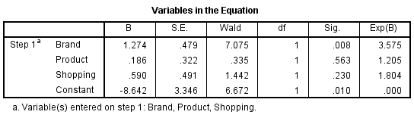
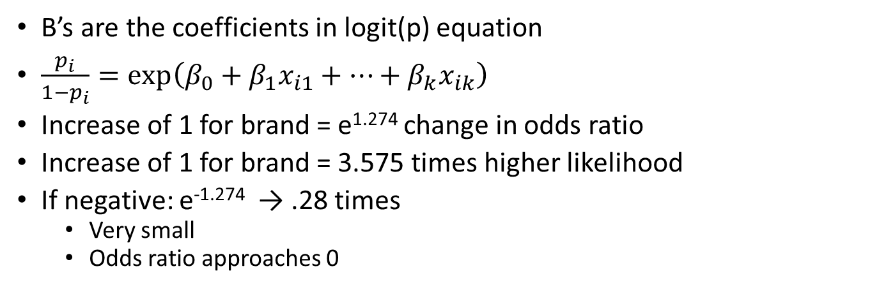
Variables in the Equation
B’s are the coefficients in logit(p) equation
$\frac{p_{i}}{1−p_{i}}=\exp\left(β_{0}+β_{1}x_{i1}+…+β_{k}x_{ik}\right)$
Increase of 1 for brand = e^{1.274} change in odds ratio
Increase of 1 for brand = 3.575 times higher likelihood
If negative: e^{-1.274} → .28 times
Very small
Odds ratio approaches 0
Notes:
This odds ratio can be computed by raising the base of the natural log (e) to the bth power, where b is the slope from our logistic regression equation.
For this model, $e^{1.274}=3.575$
This tells us that the model predicts that the odds of being loyal are 3.575 times higher for one unit increase in brand attitude.

Slide 25
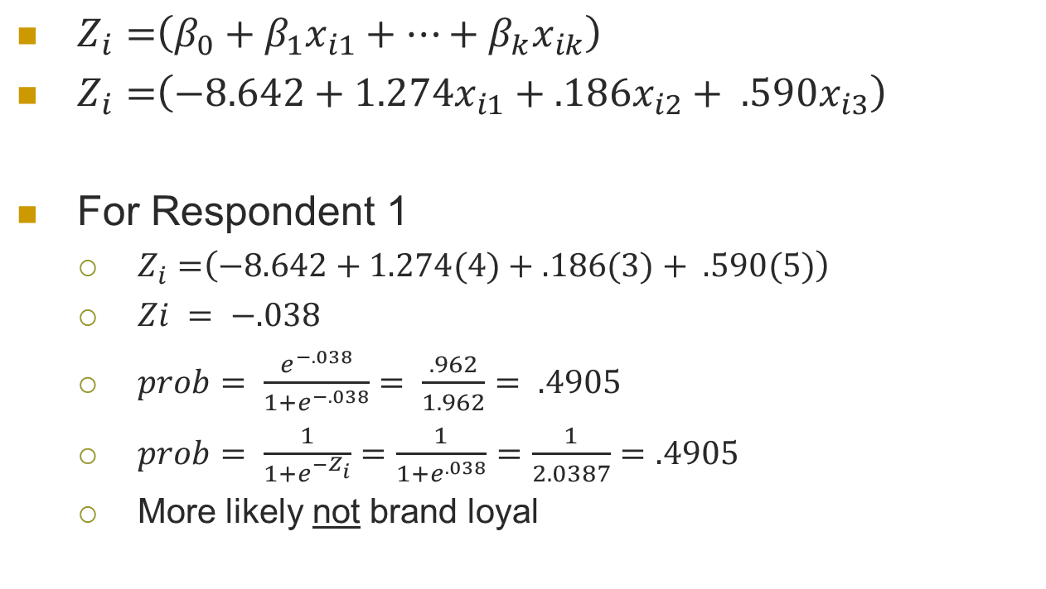
Predicting Probabilities
$Z_{i}=\left(β_{0}+β_{1}x_{i1}+…+β_{k}x_{ik}\right)$
$Z_{i}=\left(−8.642+1.274x_{i1}+.186x_{i2}+ .590x_{i3}\right)$
For Respondent 1
$Z_{i}=\left(−8.642+1.274(4)+.186(3)+ .590(5)\right)$
$Zi = −.038$
$prob= \frac{e^{−.038}}{1+e^{−.038}}= \frac{.962}{1.962}= .4905$
$prob= \frac{1}{1+e^{{−Z}_{i}}}=\frac{1}{1+e^{.038}}=\frac{1}{2.0387}=.4905$
More likely not brand loyal

Slide 26
Variable in the Equation
Wald statistic instead of t-stat
Sig. is same as before (< 0.05 is good)
Which variables are significant?
Notes:
Understanding coefficients:
Product does not contribute to the model
The positive B indicates that the loyal group (1) tends to have higher average attitudes towards the product than the non-loyal group (0) - but not significantly, after controlling for the other predictors
Shopping does not contribute to the model
The positive B for shopping indicates higher average attitudes among the loyal (1) group, after controlling for other predictors – but not significantly, after controlling for the other predictors
Brand does contribute to the model, with higher average attitudes among the loyal (1) group, after controlling for other predictors

Slide 27
Putting it all together
Logistic regression performed
Predict loyalty
From attitudes towards brand, product, & shopping
Good model
Chi-square test shows at least one predictor helps
60.4% of variance explained
80% of cases classified correctly
Coefficients
Increase in attitude towards brand increases likelihood of being loyal 3.6 times
Notes:
A logistic regression was performed to ascertain the effects of attitudes towards the brand, product, and shopping on the likelihood that participants are loyal to the brand.
The logistic regression model was statistically significant, χ²(3) = 18.117, p < .05.
The model explained 60.4% (Nagelkerke R²) of the variance in brand loyalty and correctly classified 80.0% of cases.
A unit increase in attitude towards the brand increased likelihood of being loyal by 3.6 times

Slide 28
BREAK 10 Mins

Slide 29
Binary Logistic vs. OLS
Data
B’s are used to calculate Z_{i}s
$Z_{i}$=$b_{0}+b_{1}x_{i1}+…+{b_{n}x}_{in}$
𝑍_𝑖=𝑏_0+𝑏_1 𝑥_𝑖1+…+〖𝑏_𝑛 𝑥〗_𝑖𝑛
Dependent variable is 0’s and 1’s
Independent variables: Same (X_{i}’s)
Obtain estimates of β’s in similar equation
Z_{i} is used to estimate the probability
$Probability of being in group= \hat{p_{i} }=\frac{e^{Z_{i}^{}}}{1+e^{Z_{i}}}= \frac{1}{1+e^{{−Z}_{i}}}$
𝑃𝑟𝑜𝑏𝑎𝑏𝑖𝑙𝑖𝑡𝑦 𝑜𝑓 𝑏𝑒𝑖𝑛𝑔 𝑖𝑛 𝑔𝑟𝑜𝑢𝑝= (𝑝_𝑖 ) ̂=𝑒^(𝑍_𝑖^ )/(1+𝑒^(𝑍_𝑖 ) )= 1/(1+𝑒^(〖−𝑍〗_𝑖 ) )

Slide 30
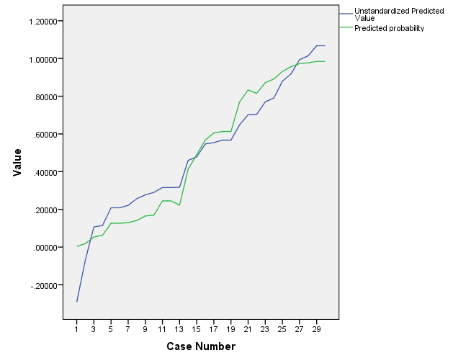
A Comparison of Predictions
Notes:
Data are sorted by predicted probabilities first
Graphs
Legacy Dialogs
Line
Multiple
Check values of individual cases
Hit Define
Identify one line for each type of prediction
Logistic
Linear
Logistic
Correct format for a dummy dependent variable
Use if you are interested in the predicted probabilities
Probabilities between 0 and 1
Use % correct as a gauge of goodness of model
Linear regression
Works well if you are interested in 0 versus 1
Cutoff shows same predictions
Predicted probabilities may be quite inaccurate
Coefficients are easier to interpret

Slide 31
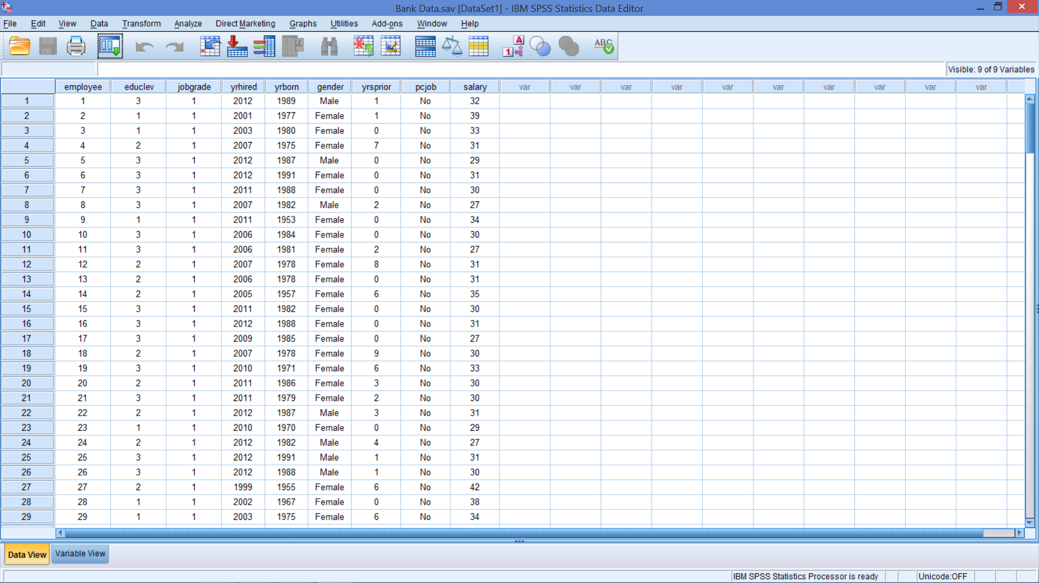
Open Bank Data.sav
Notes:
Open Bank data.sav
Can you predict gender from salary?

Slide 32
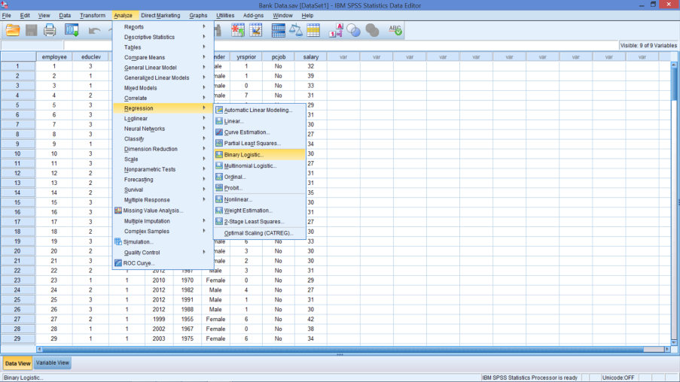
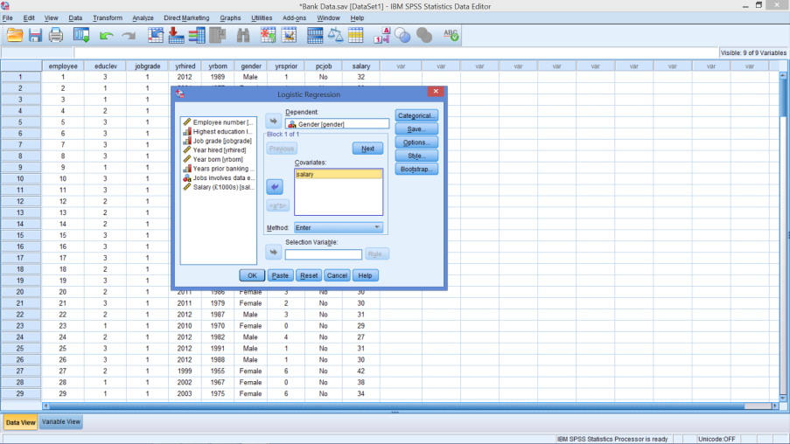
Predict Gender from Salary
Notes:
DV = gender (No need to recode)
IV = Salary
Don’t worry about options and save specifications

Slide 33
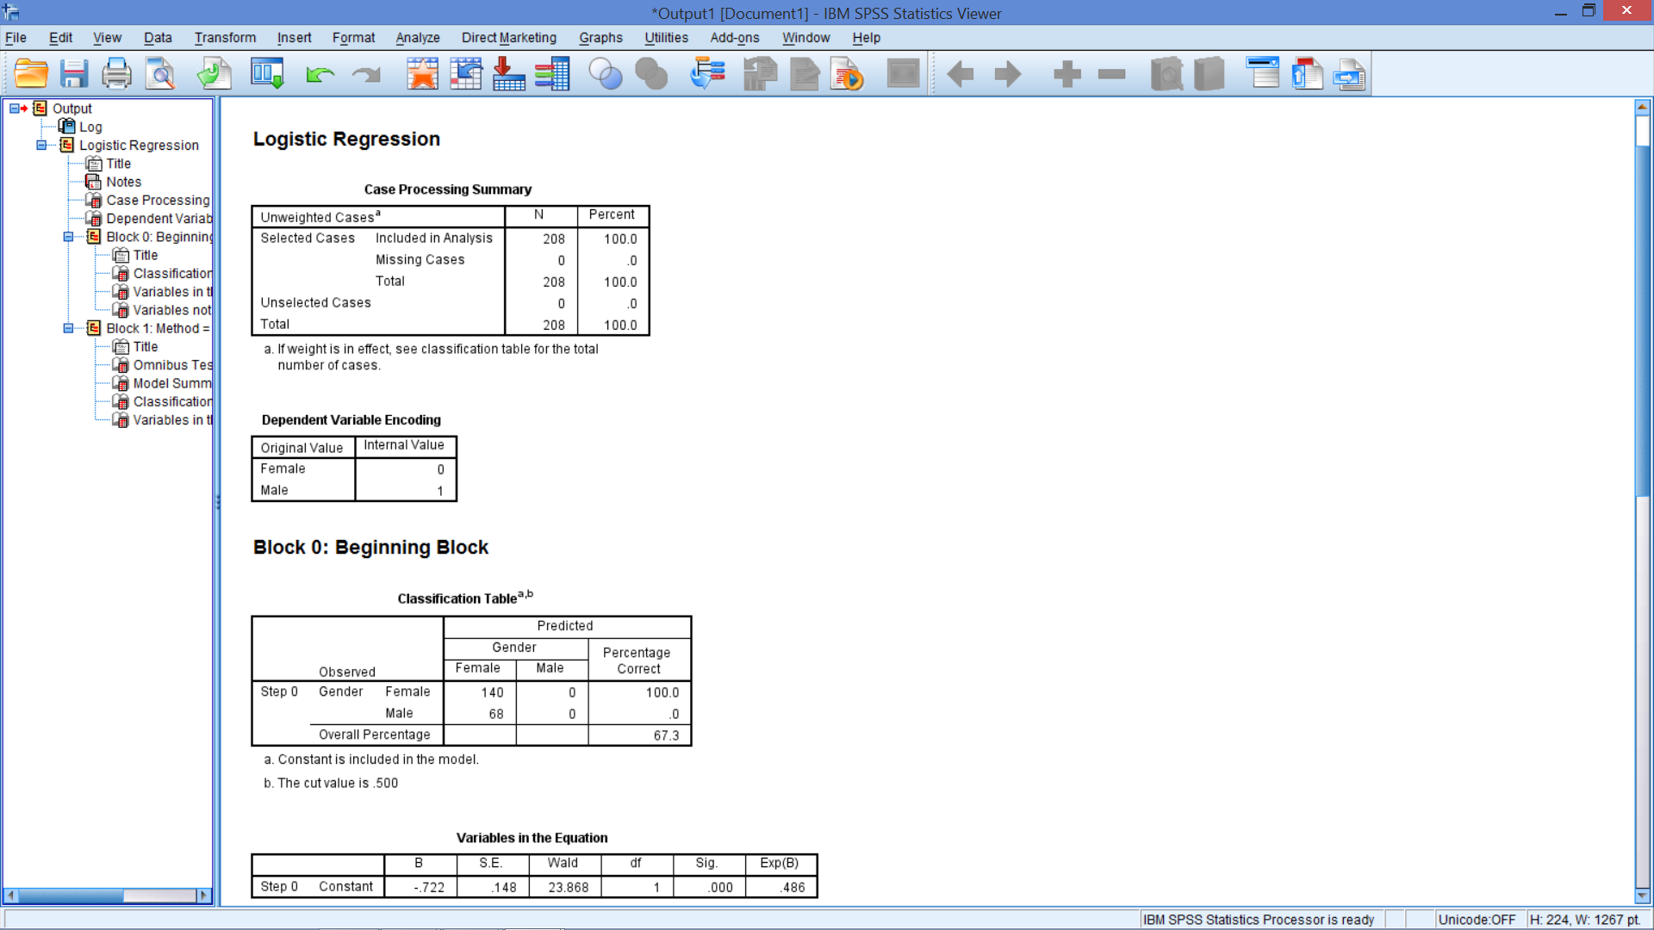
SPSS Codes the DV
SPSS does this alphabetically

Slide 34
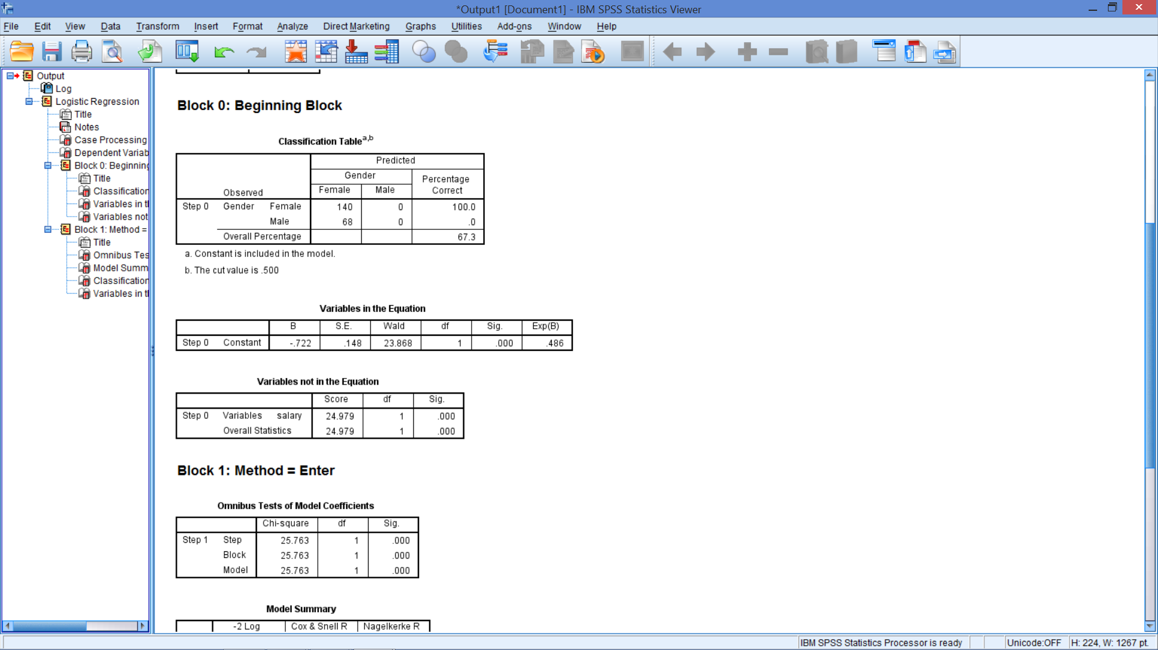
Block 0: No Predictors
% reflects the category with the highest number of responses
Odds ratio:
.673 / (1-.673) = 2.0581
Constant
-ln(2.058) = -.7218
Negative because .673 is associated with female (coded as 0 not 1)
Odds of male = e^{-0.722} = .486 times
More likely female
Notes:
Prob(female)
140/208 = .673
SPSS estimates the probability of the category with the highest frequency
Odds ratio:
.673 / (1-.673) = .673/.327 = 2.0581
Constant
-ln(2.058) = -.7218
Negative because .673 is associated with female – coded as 0 not 1
Reducing odds of being male
Odds of male = e^{-0.722} = .486 times

Slide 35
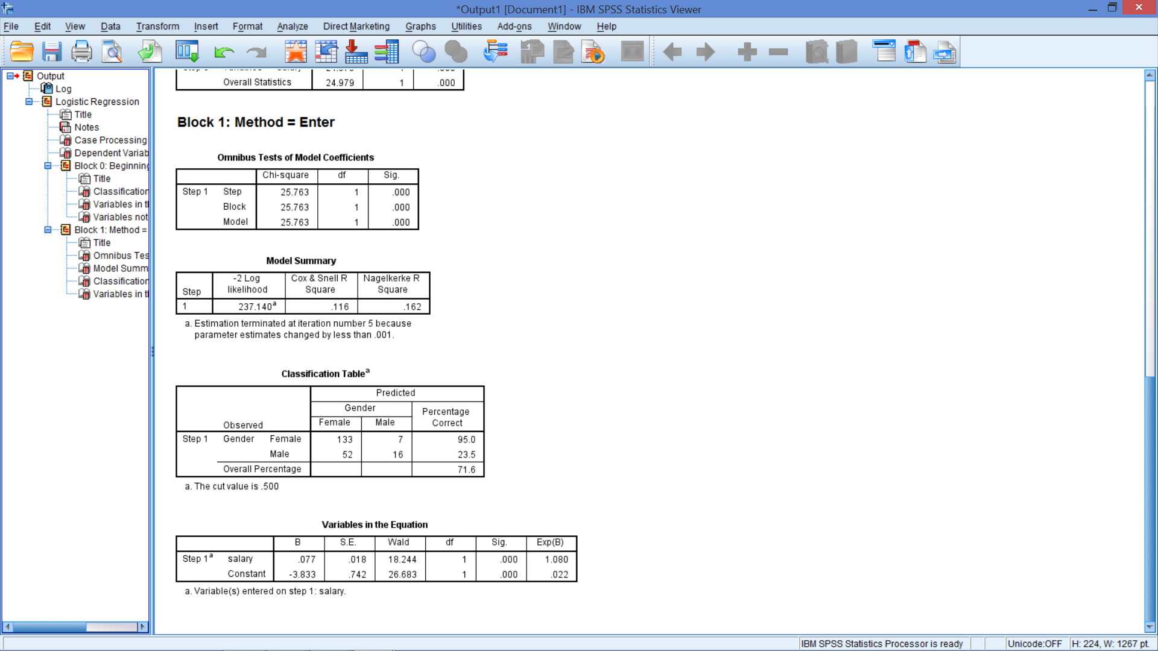
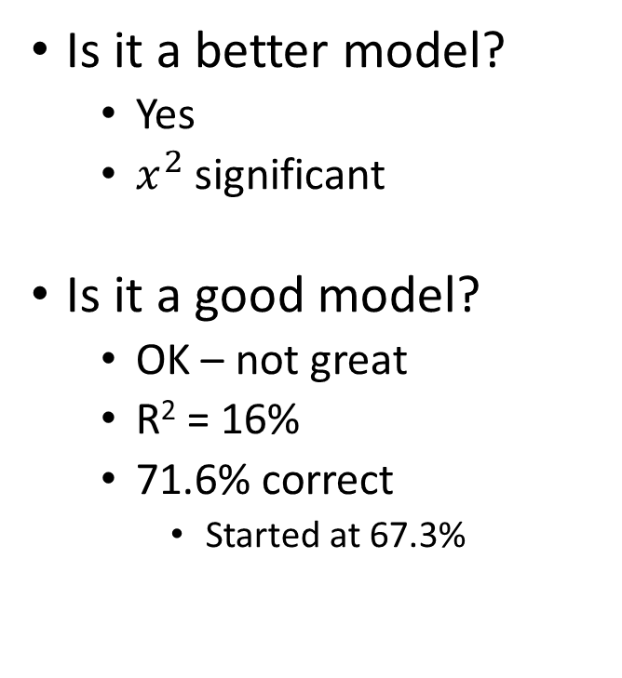
Full Model
Is it a better model?
Yes
$x^{2}$ significant
Is it a good model?
OK – not great
R² = 16%
71.6% correct
Started at 67.3%

Slide 36
Full Model
Salary
Significant in predicting gender?
Interpretation
An increase in salary by 1 unit?
Increase in odds of male by 1.08 times
What next?

Slide 37
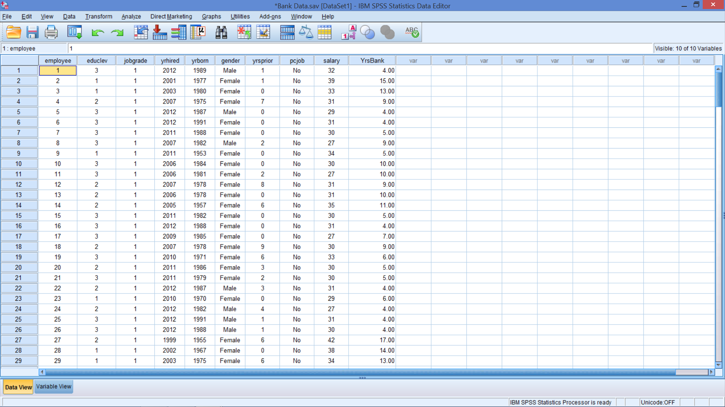
Create Years at the Bank
Notes:
You need to calculate years at the bank as before
2016 – Year Hired

Slide 38
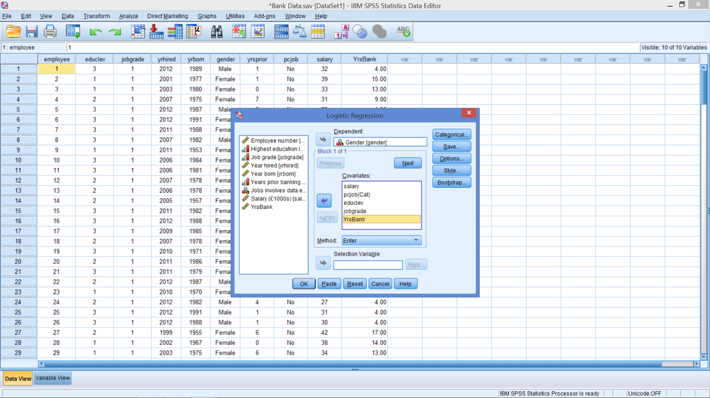
New Logistic Regression Model
Add pcjob, education level, job grade, years at bank
Notes:
Add pcjob, education level, job grade, years at bank to improve the regression.
You do not need to recode the categorical variables, just tell SPSS which ones are categorical and what level you want in the constant (the reference category)
See next slide

Slide 39
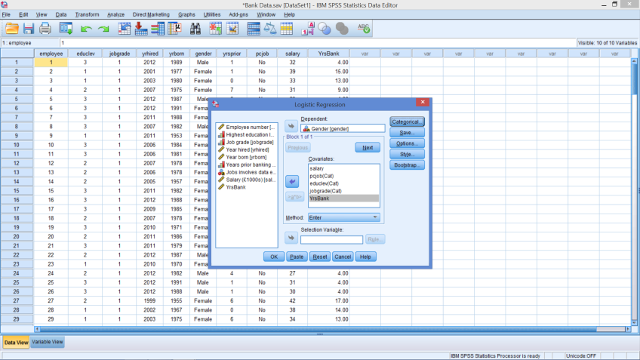
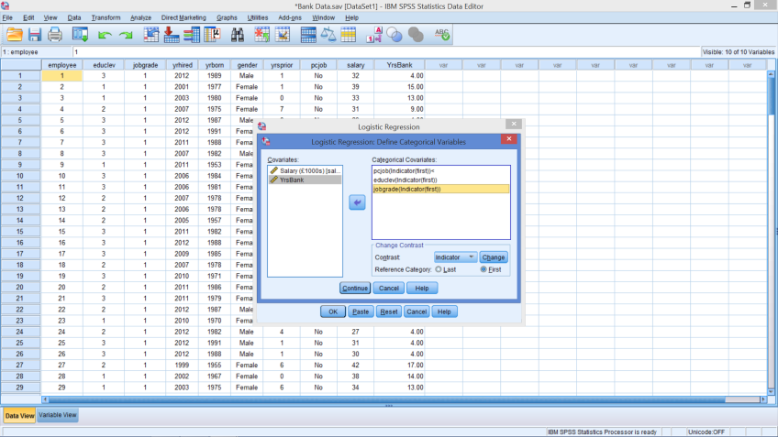
Note: With Categorical IV
No need to recode all categories into 1 / 0 variables
Tell SPSS to ignore the fact that these are numbers
Tell SPSS to create dummy variables for each level
Tell SPSS what level will be in intercept (constant)
Reference category
Notes:
Add pcjob, education level, job grade, years at bank
For categorical variables
Move the categorical variable into the box with the arrow
Tell SPSS if it is an indicator (dummy variable)
Tell SPSS what category is the reference category
Be sure to hit change button so that (first) appears with variable – if that is what you want

Slide 40
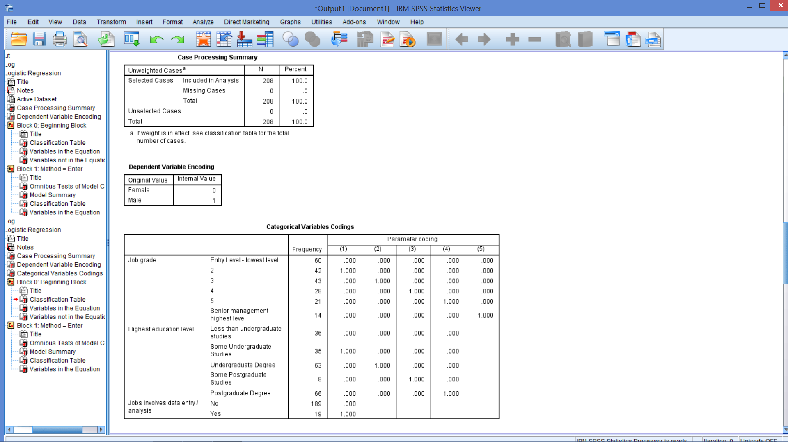
Note How SPSS Coded Data

Slide 41
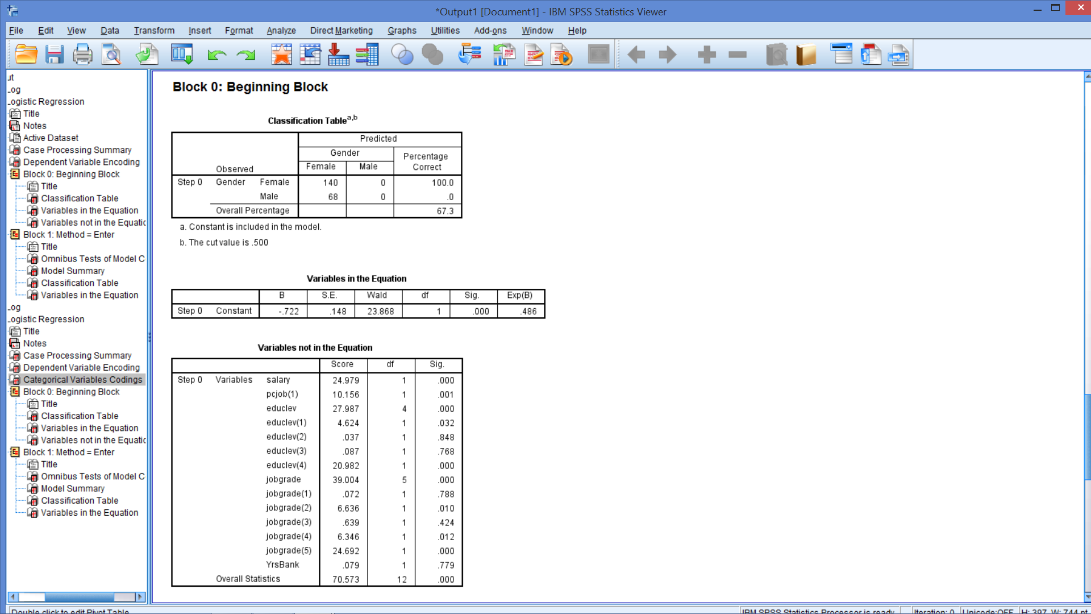
No Predictors
Notes:
Same except for all the variables that are now listed as not being in the model.

Slide 42
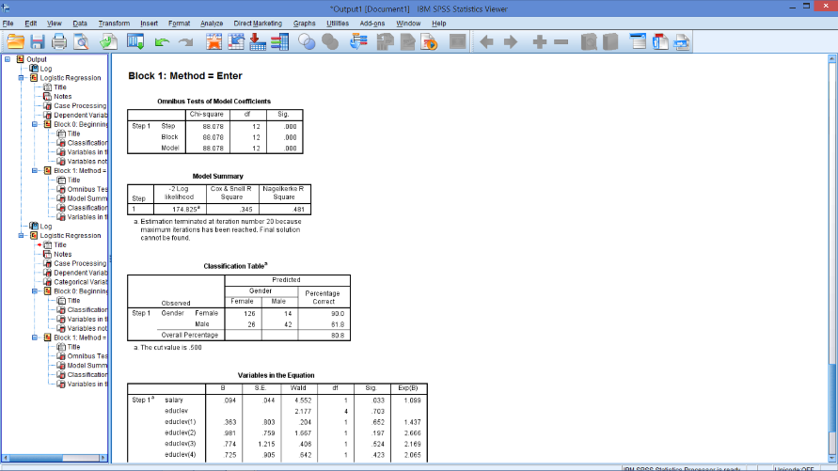
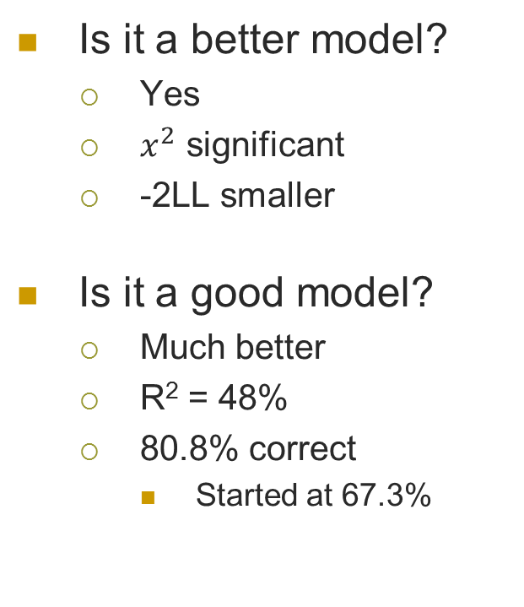
Model Output
Is it a better model?
Yes
$x^{2}$ significant
-2LL smaller
Is it a good model?
Much better
R² = 48%
80.8% correct
Started at 67.3%

Slide 43
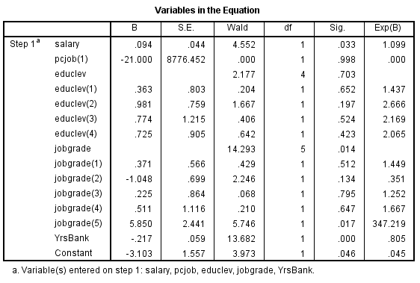
Variables in the Equation
Higher job grade (not 2) & salary indicate male – More years at bank indicate female
Notes:
Note that SPSS provides the overall significance of a factor (education level & job grade) as well as the significance of each level as specified in the model
As salary increases the likelihood of male is 1.099 times higher than for female
Education has no impact on likelihood of male
Data analysis (PCJob) has no impact on likelihood of male
Job grade has a significant impact
Based on highest level being significant
Positive coefficient
Increases likelihood of male
Years at the Bank
Negative & significant
Increased years at bank, the likelihood of male is .8 times more likely
More likely female
Constant
More likely female
More females in sample than males

Slide 44
Similarities and Differences
 | ANOVA | (OLS) Regression | Logistic Regression
Similarities
Number of DVs | One | One | One
Number of IVs | Multiple | Multiple | Multiple
Differences
Nature of DVs | Metric | Metric | Categorical
Nature of IVs | At least One Categorical | Metric and/or Categorical | Metric and/or Categorical

Slide 45
In-class Problem – Bank loan.sav
Who are good loan customers for this bank?
DV: Default
Possible IVs: age, education, time with current employer, time at current address, income, debt to income ratio, credit card debt, and other debt
Which variable(s) predict probability of defaulting?
Open Bank loan.sav
Estimate the best binary logistic regression model
Answer questions on next slide

Slide 46
Answer these questions
Is it a good model?
Yes – 81.4%
Which sig. variable(s) positively impact defaulting?
Debt to income ratio
Credit card debt
Which sig. variable(s) negatively impact defaulting?
Time with current employer
Time at current address
How would you describe good prospects for loans?
Does the model have a good prediction rate?
Chi-sq is significant
R² = 44.1%

Slide 47
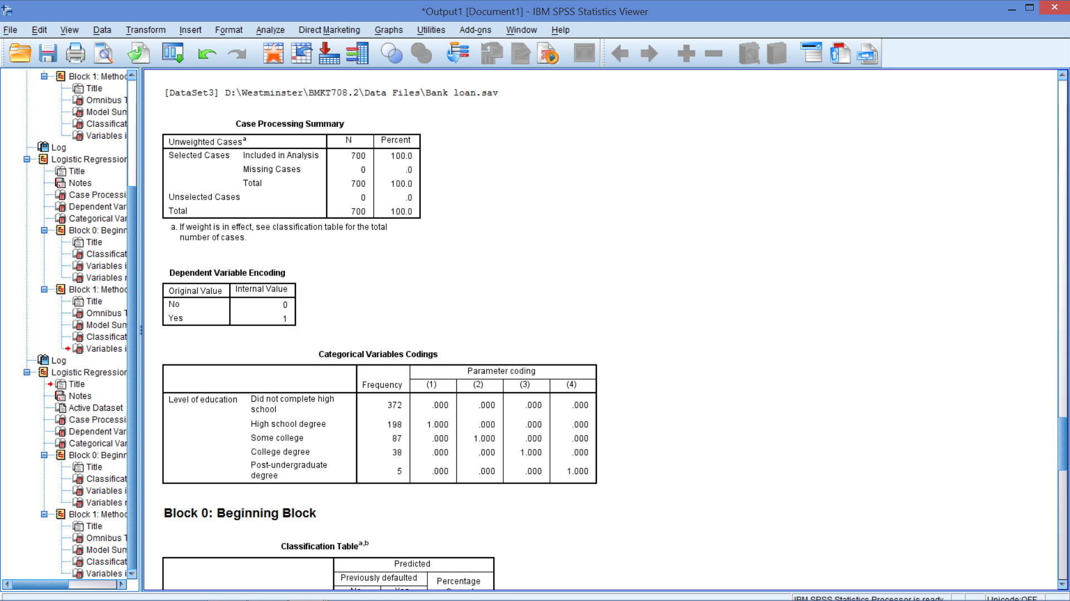
Getting Started
Predicting defaulting – Poor customers
Education is categorical

Slide 48
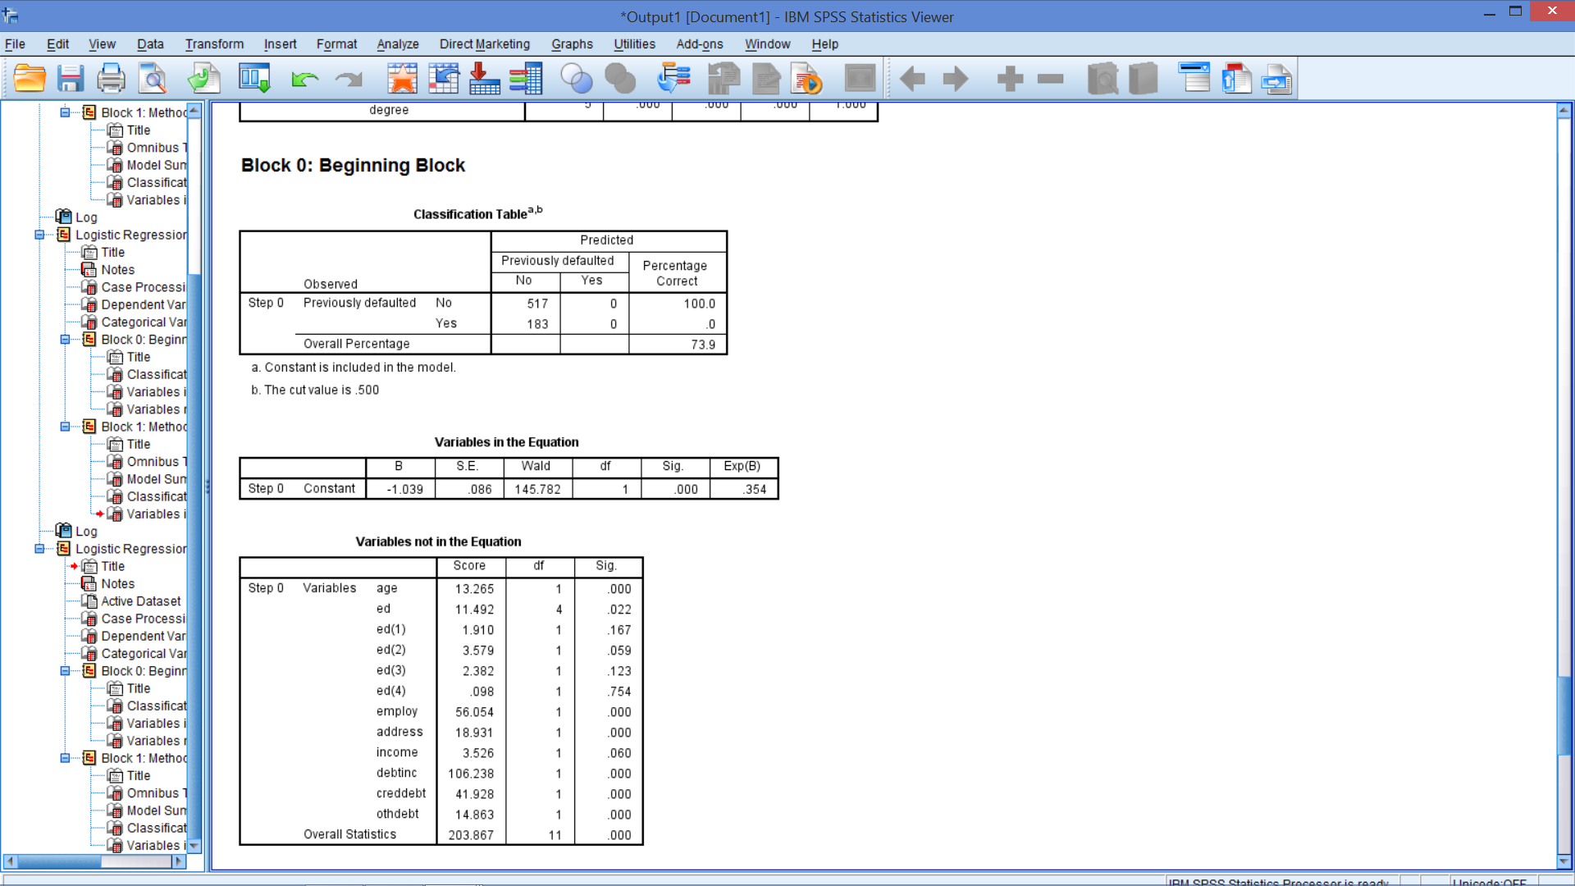
Block 0
Highest frequency category
Constant is negative because this category is 0
e^{-1.039} = .354

Slide 49
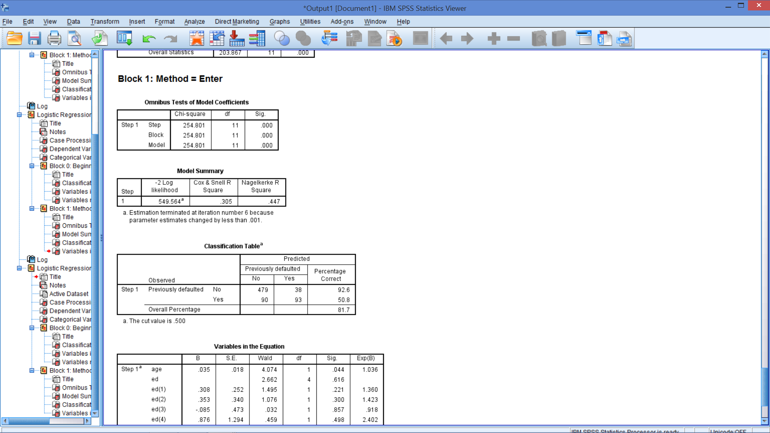
Is it a good model?

Slide 50
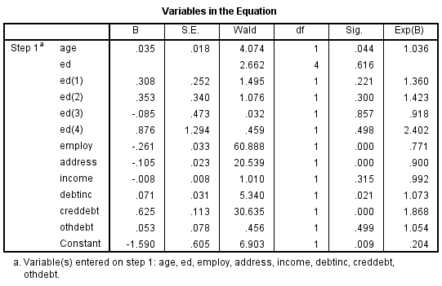
Predictor Variables
Notes:
Education is not significant
Income is not significant
Other debt is not significant

Slide 51

Revised – Final Model

Slide 52
Answer these questions
Is it a good model?
Yes – 81.4%
Which sig. variable(s) positively impact defaulting?
Age
Credit card debt
Which sig. variable(s) negatively impact defaulting?
Time with current employer
Time at current address
How would you describe good prospects for loans?
Does the model have a good prediction rate?
Chi-sq is significant
R² = 44.1%
Debt to income ratio

Slide 53
Answer these questions
Is it a good model?
Yes – 81.4%
Which sig. variable(s) positively impact defaulting?
Age
Credit card debt
Which sig. variable(s) negatively impact defaulting?
Time with current employer
Time at current address
How would you describe good prospects for loans?
Does the model have a good prediction rate?
Chi-sq is significant
R² = 44.1%
Debt to income ratio

Slide 54
Answer these questions
Is it a good model?
Yes – 81.4%
Which sig. variable(s) positively impact defaulting?
Age
Credit card debt
Which sig. variable(s) negatively impact defaulting?
Time with current employer
Time at current address
How would you describe good prospects for loans?
Does the model have a good prediction rate?
Chi-sq is significant
R² = 44.1%
Debt to income ratio

Slide 55
Answer these questions
Is it a good model?
Yes – 81.4%
Which sig. variable(s) positively impact defaulting?
Age
Credit card debt
Which sig. variable(s) negatively impact defaulting?
Time with current employer
Time at current address
How would you describe good prospects for loans?
Does the model have a good prediction rate?
Chi-sq is significant
R² = 44.1%
Debt to income ratio

Slide 56
Answer these questions
Is it a good model?
Yes – 81.4%
Which sig. variable(s) positively impact defaulting?
Age
Credit card debt
Which sig. variable(s) negatively impact defaulting?
Time with current employer
Time at current address
How would you describe good prospects for loans?
Does the model have a good prediction rate?
Chi-sq is significant
R² = 44.1%
Debt to income ratio

Slide 57
Putting it all together
Logistic regression performed
Predict defaulting on bank loan
From time with current employer, time at current address, debt to income ratio and credit card debt
Good model
Chi-square test shows at least one predictor helps
44.1% of variance explained
81.4% of cases classified correctly
Coefficients
Increase in
Age increases likelihood of defaulting 1.033 times
Debt to income ratio increases likelihood of defaulting 1.093 times
Credit card debt increases likelihood of defaulting 1.773 times
Increase in
Years with employer Increases likelihood of defaulting .77 times
More likely not defaulting
Years at address increases likelihood of defaulting .902 times
More likely not defaulting

Slide 58
What’s Next?
Practice reading models & analyses
Next topic – Factor Analysis

